Slide 1
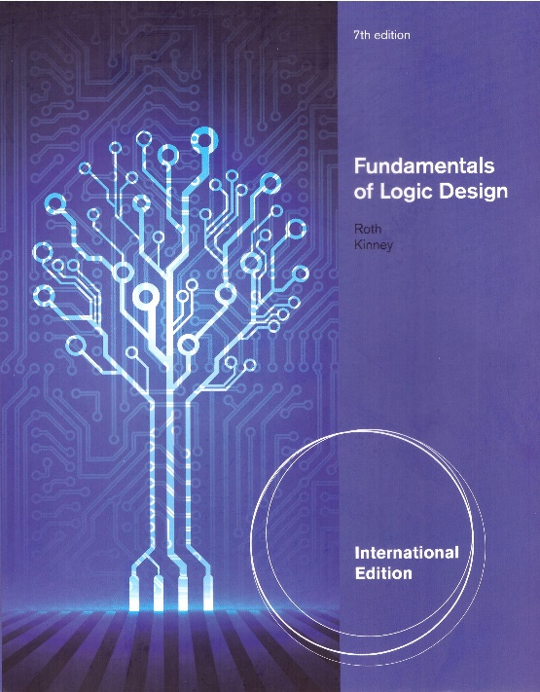
Unit 5
KARNAUGH MAPS
This chapter in the book includes:
Objectives
Study Guide
5.1 Minimum Forms of Switching Functions
5.2 Two- and Three-Variable Karnaugh Maps
5.3 Four-Variable Karnaugh Maps
5.4 Determination of Minimum Expressions
5.5 Five-Variable Karnaugh Maps
5.6 Other Uses of Karnaugh Maps
5.7 Other Forms of Karnaugh Maps
Programmed Exercises
Problems

Slide 2
Objectives
Topics introduced in this chapter:
Given a function (completely or incompletely specified) of three
to five variable, plot it on a Karnaugh map.
The function may be given in minterm, maxterm, or algebraic form.
Determine the essential prime implicants of a function from a map.
Obtain the minimum sum-of-products or minimum
product-of-sums form of a function from the map.
Determine all of the prime implicants of a function from a map.
Understand the relation between operations performed using
the map and the corresponding algebraic operation.

Slide 3
5.1 Minimum Forms of Switching Functions
Combine terms by using
Do this repeatedly to eliminate as many literals as possible.
A given term may be used more than once because
2. Eliminate redundant terms by using the consensus theorems.
Why Simplify?
Volume, Speed, Cost
Power consumption
Reliability

Slide 4
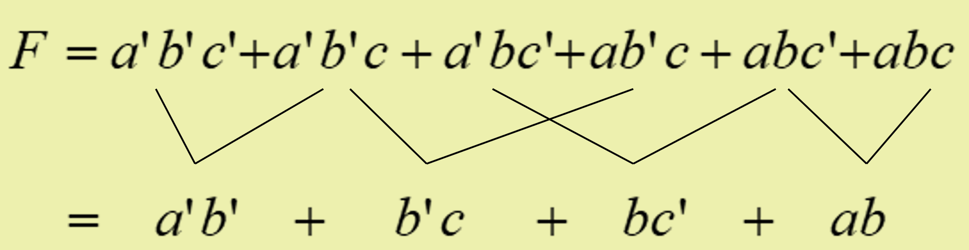

5.1 Minimum Forms of Switching Functions
Example: Find a minimum sum-of-products
Approach 1
What is the right answer?
Dizzy @@@
Approach 1

Slide 5

5.1 Minimum Forms of Switching Functions
Example: Find a minimum product-of-sums
Eliminate by consensus
Are you sure?

Slide 6

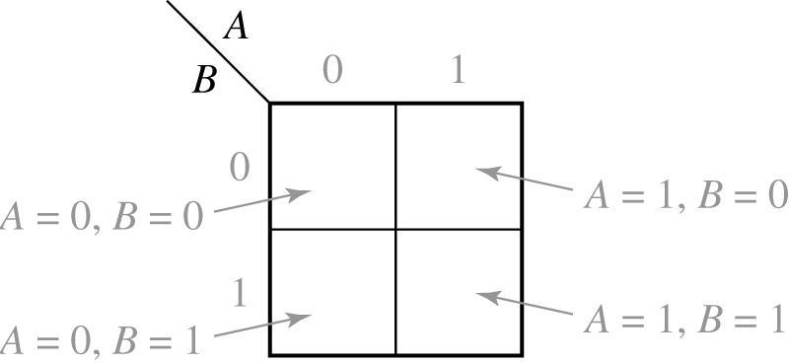
5.2 Two- and Three-Variable Karnaugh Maps
A 2-variable Karnaugh Map
Hawk eye
Not just brain

Slide 7
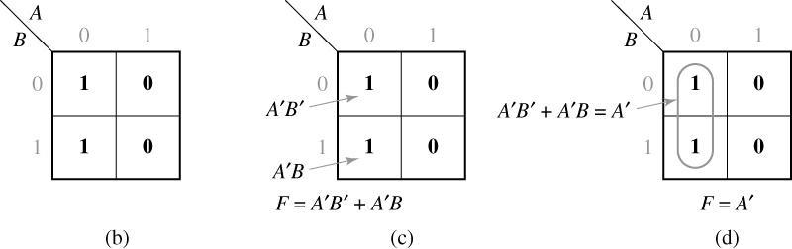
5.2 Two- and Three-Variable Karnaugh Maps
Truth Table for a function F
A B
F
0
0 0
0 1
1 0
1 1
1
1
0
0
1
2
Good Neighbors
3
(a)
0
2
1
3

Slide 8
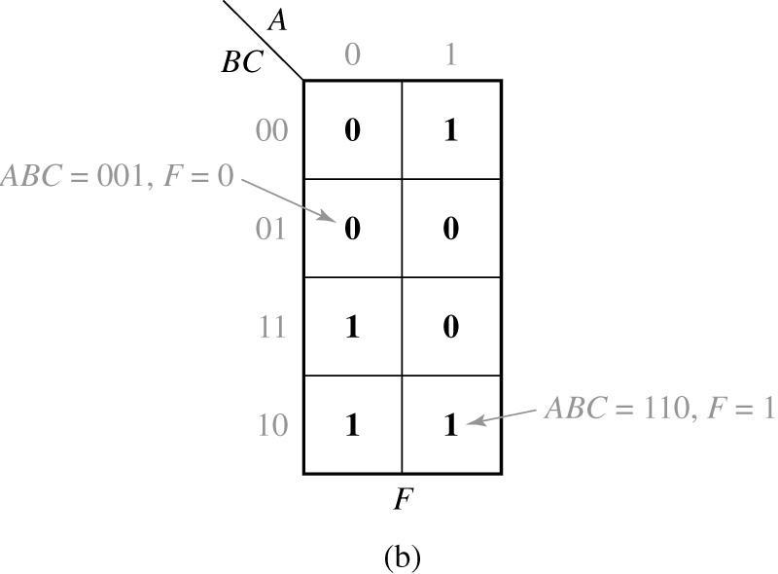
5.2 Two- and Three-Variable Karnaugh Maps
Truth Table and Karnaugh Map for Three-Variable Function
A B C
F
0 0 0
0 0 1
0 1 0
0 1 1
1 0 0
1 0 1
1 1 0
1 1 1
0
0
1
1
1
0
1
0
(a)

Slide 9
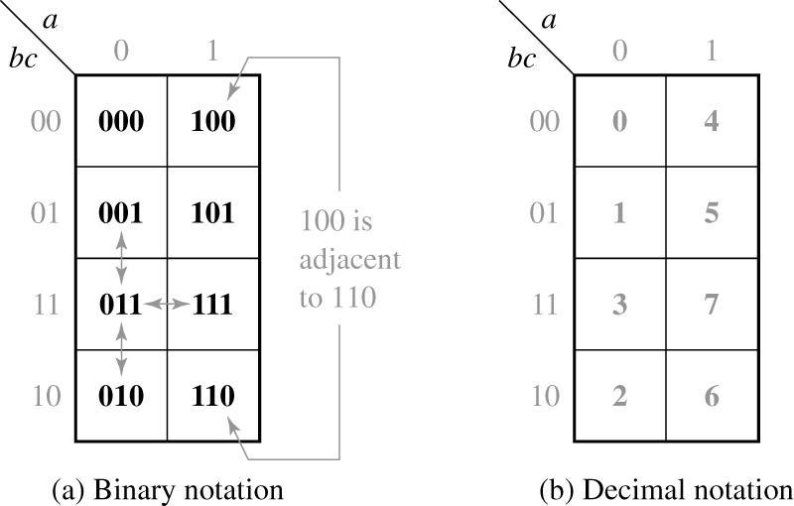
5.2 Two- and Three-Variable Karnaugh Maps
Location of Minterms on a Three-Variable Karnaugh Map
Why Location Shift?
Good Neighbors

Slide 10
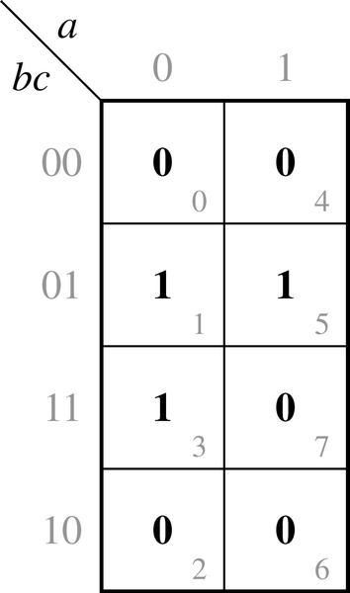
5.2 Two- and Three-Variable Karnaugh Maps
Karnaugh Map of F(a, b, c) = m(1, 3, 5) = ∏ M(0, 2, 4, 6, 7)

Slide 11
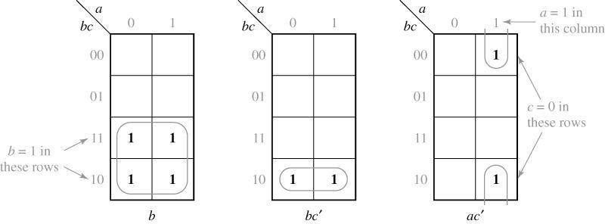
5.2 Two- and Three-Variable Karnaugh Maps
Karnaugh Maps for Product Terms

Slide 12
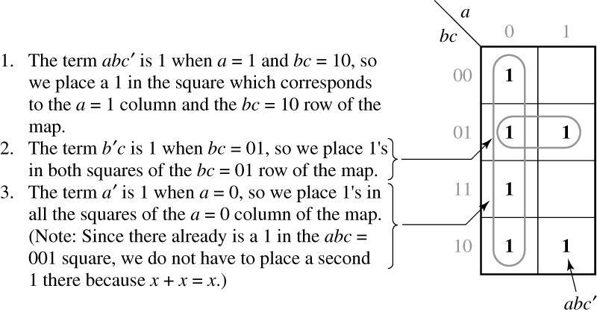
5.2 Two- and Three-Variable Karnaugh Maps
Given Function

Slide 13
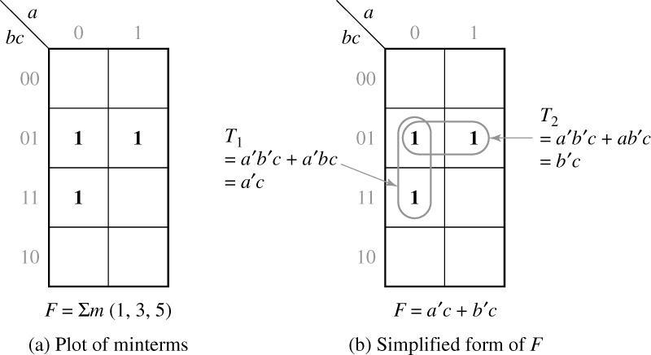
5.2 Two- and Three-Variable Karnaugh Maps
Simplification of a Three-Variable Function

Slide 14
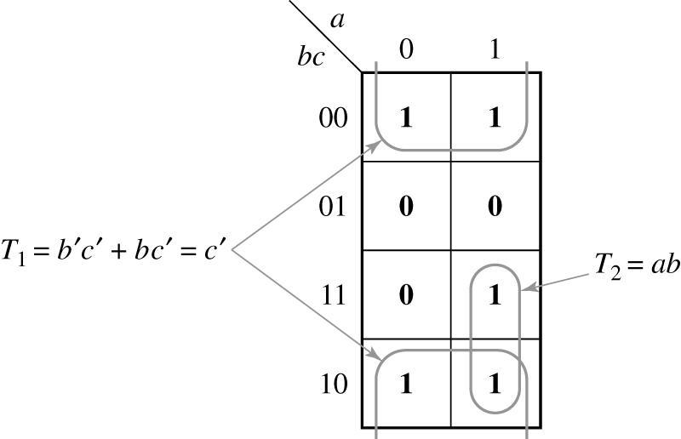
5.2 Two- and Three-Variable Karnaugh Maps
Complement of Map in Figure 5-6(a)

Slide 15
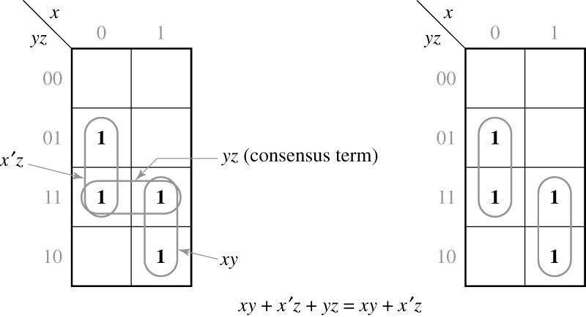
5.2 Two- and Three-Variable Karnaugh Maps
Karnaugh Maps Which Illustrate the Consensus Theorem
Consensus term is redundant

Slide 16
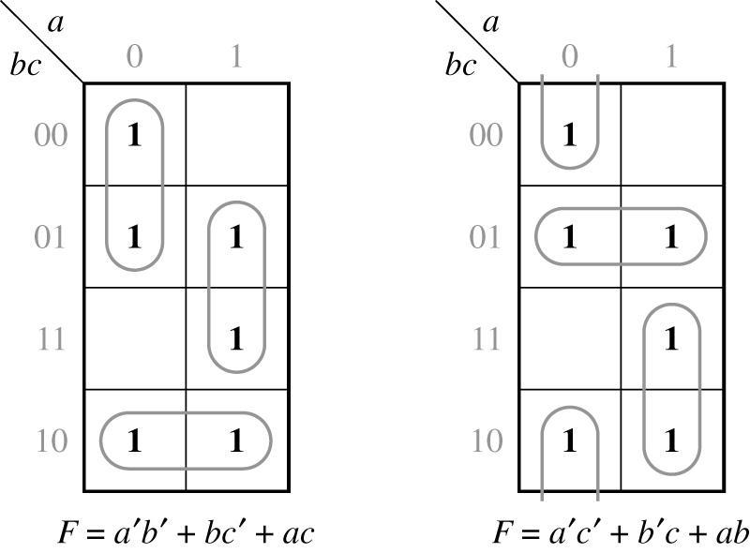
5.2 Two- and Three-Variable Karnaugh Maps
Function with Two Minimal Forms

Slide 17
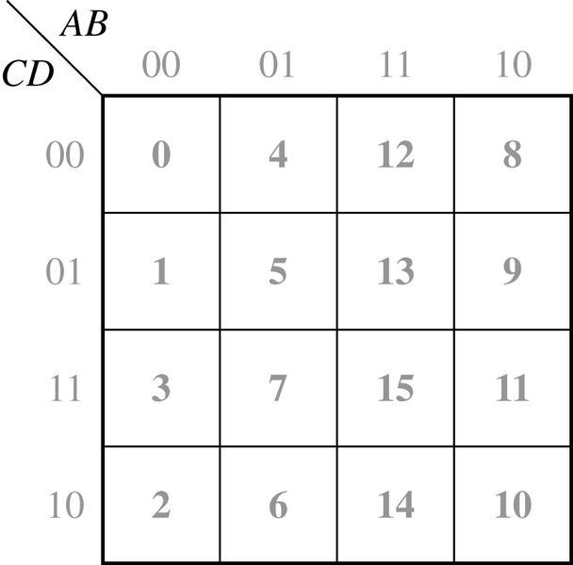
5.3 Four-Variable Karnaugh Maps
Location of Minterms on Four-Variable Karnaugh Map
Good Neighbors
The Bigger,
The Better!

Slide 18
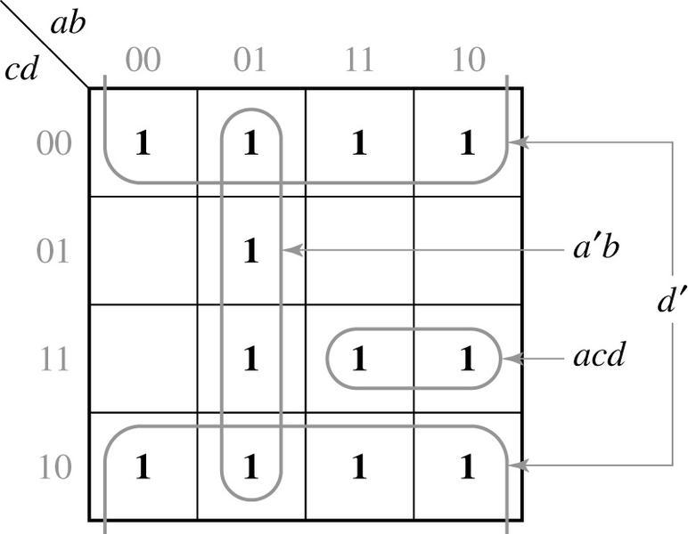
5.3 Four-Variable Karnaugh Maps
Plot of acd + a’b + d’

Slide 19
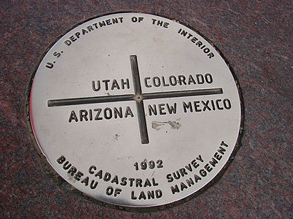
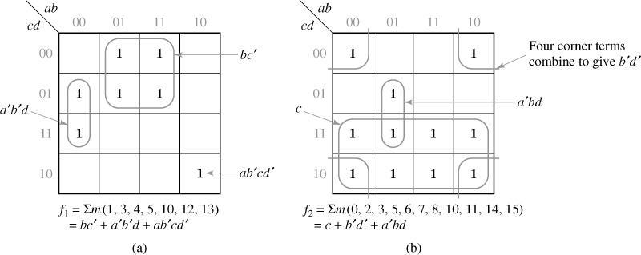
5.3 Four-Variable Karnaugh Maps
Simplification of Four-Variable Functions

Slide 20
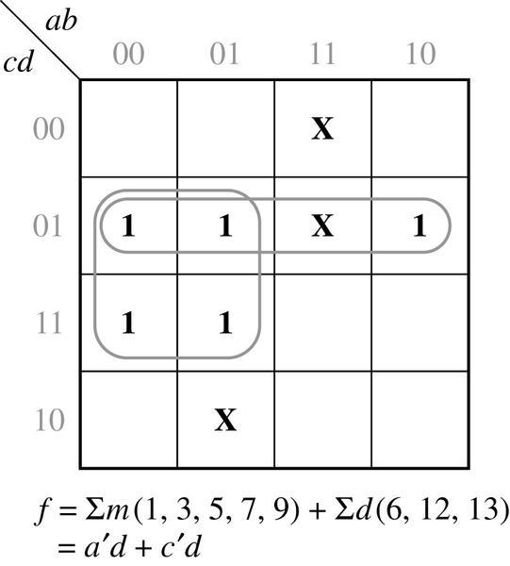
5.3 Four-Variable Karnaugh Maps
Simplification of an Incompletely Specified Function
Don’t care term

Slide 21
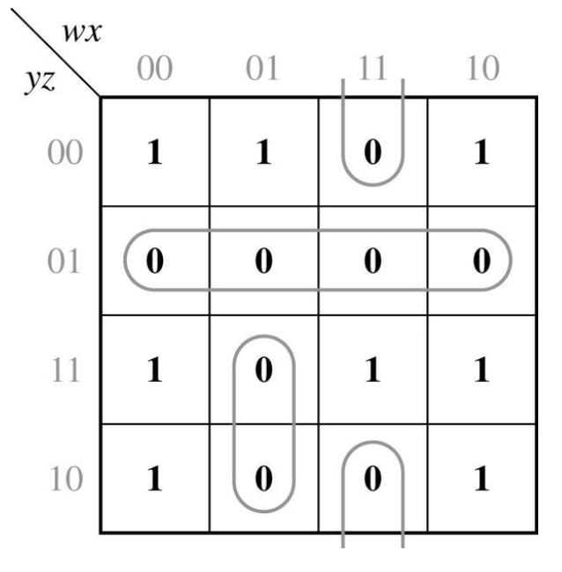
5.3 Four-Variable Karnaugh Maps

Slide 22
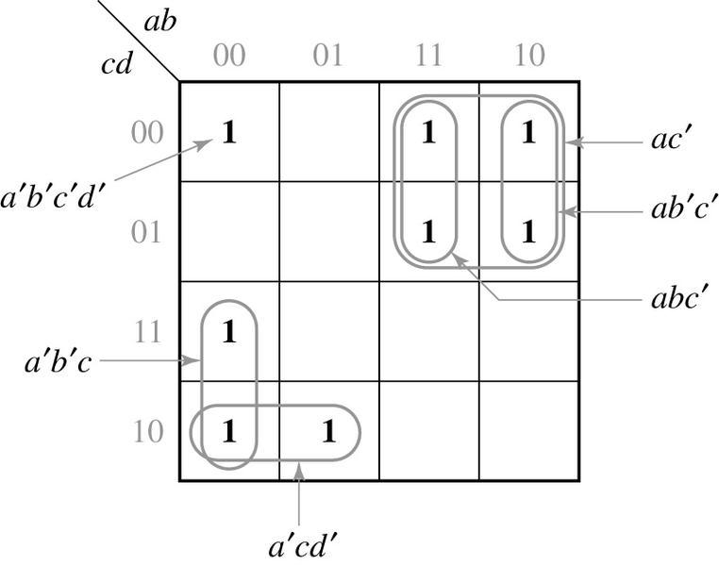
5.4 Determination of Minimum Expressions Using Essential Prime Implicants
- Implicants of F : Any single ‘1’ or any group of “1’s which can be combined together on a Map
- Prime implicants of F : A product term if it can not be combined with other terms to eliminate variable
It is not a prime implicant
since it can be combined
with other terms
Prime implicant
It is not a prime implicant
since it can be combined
with other terms
Prime implicants

Slide 23
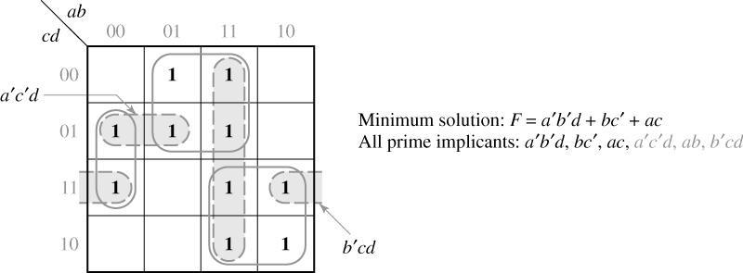
5.4 Determination of Minimum Expressions Using Essential Prime Implicants
Determination of All Prime Implicants

Slide 24
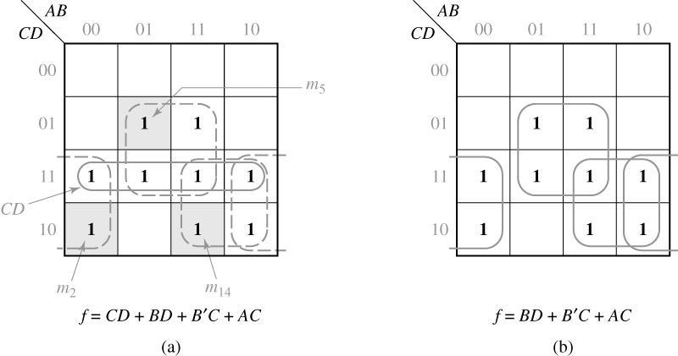
5.4 Determination of Minimum Expressions Using Essential Prime Implicants
Because all of the prime implicants of a function are generally not needed in forming the minimum sum of products, selecting prime implicants is needed.
- CD is not needed to cover for minimum expression
B’C , AC , BD are “essential” prime implicants
CD is not an “essential “ prime implicants

Slide 25
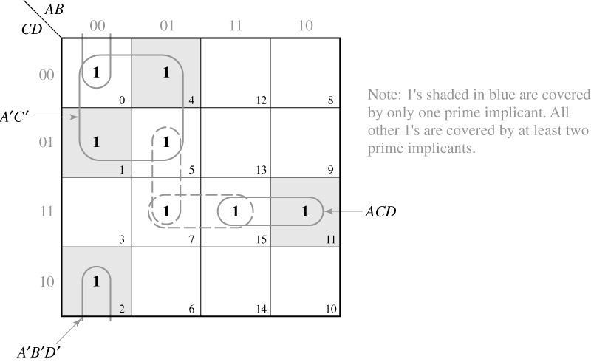
5.4 Determination of Minimum Expressions Using Essential Prime Implicants
First, find essential prime implicants
If minterms are not covered by essential prime implicants only, more prime implicants must be added to form minimum expression.

Slide 26
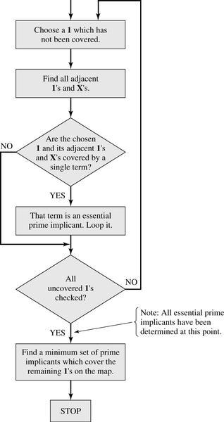
5.4 Determination of Minimum Expressions Using Essential Prime Implicants
Flowchart for Determining a Minimum Sum of Products Using a Karnaugh Map

Slide 27
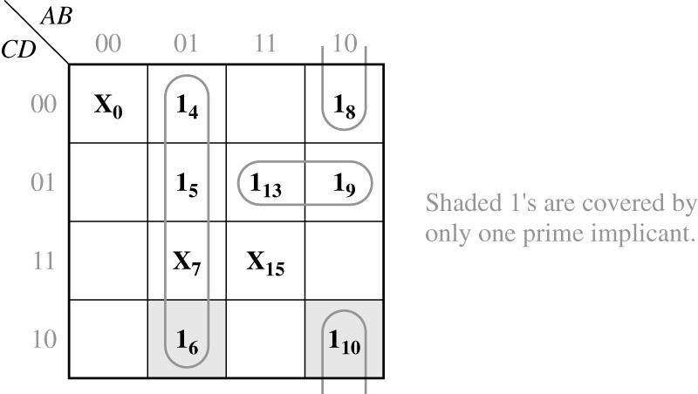
5.4 Determination of Minimum Expressions Using Essential Prime Implicants
A’B covers I₆ and its adjacent → essential PI
AB’D’ covers I₁₀ and its adjacent → essential PI
AC’D is chosen for minimal cover → AC’D is not an essential PI

Slide 28
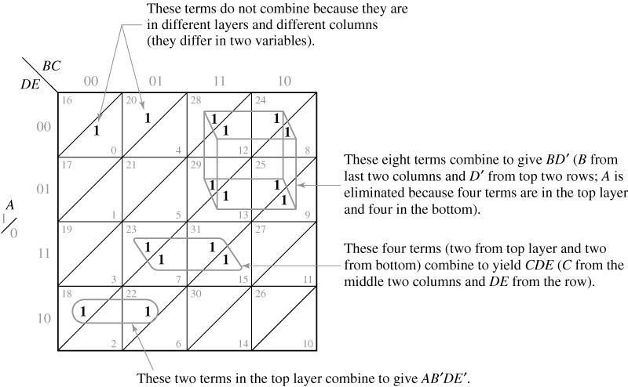
5.5 Five-Variable Karnaugh Maps
Five-Variable Karnaugh Map

Slide 29
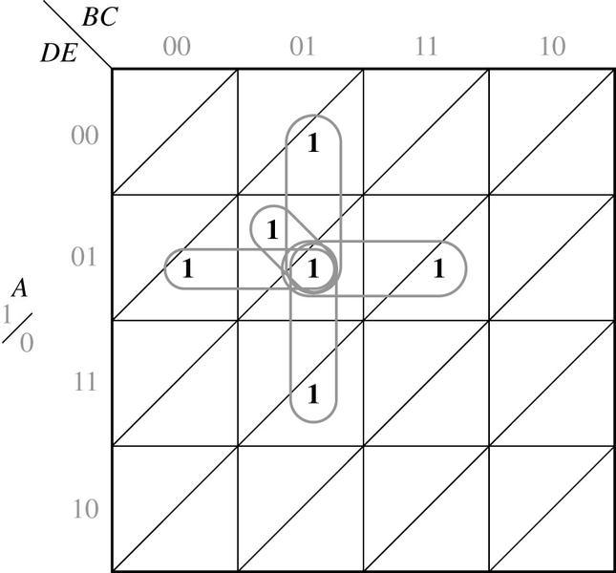
5.5 Five-Variable Karnaugh Maps

Slide 30
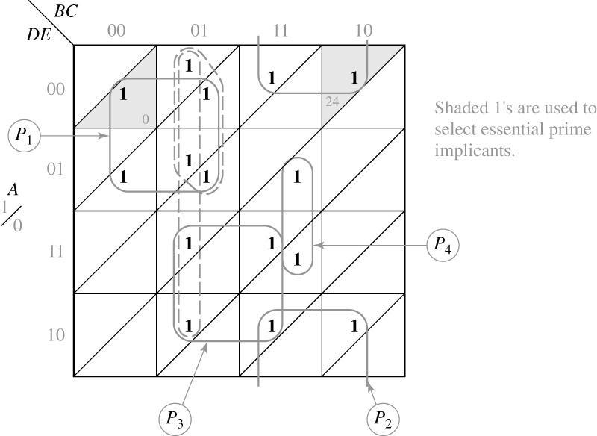
5.5 Five-Variable Karnaugh Maps
F
(
A
=
∑
,
B
,
C
,
D
,
E
)
m
(
0
,
1
,
4
,
5
,
13
,
15
,
20
,
21
,
22
,
23
,
24
,
26
,
28
,
30
,
31
)
Resulting minimum solution

Slide 31
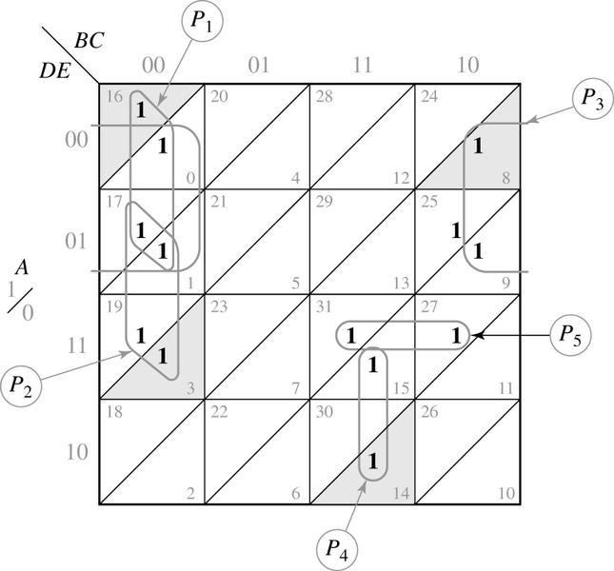
5.5 Five-Variable Karnaugh Maps
Final solution

Slide 32
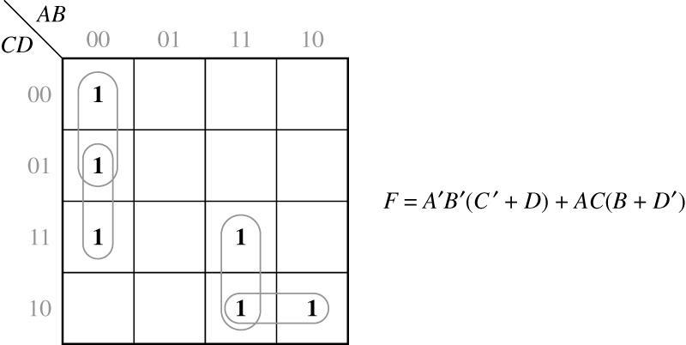
5.6 Other Uses of Karnaugh Maps
Minterm expansion of f is f = m(0,2,3,4,8,10,11,15)
Maxterm expansion of f is f = m(1,5,6,7,9,12,13,14)
∑
∏
same
Show the conventional solution
2. Compare the gates and literals

Slide 33
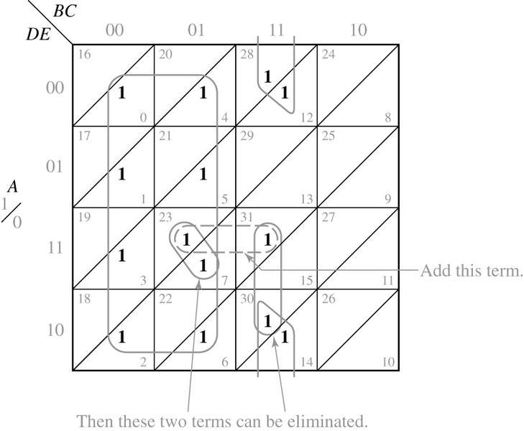
5.6 Other Uses of Karnaugh Maps
ACDE

Slide 34
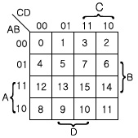
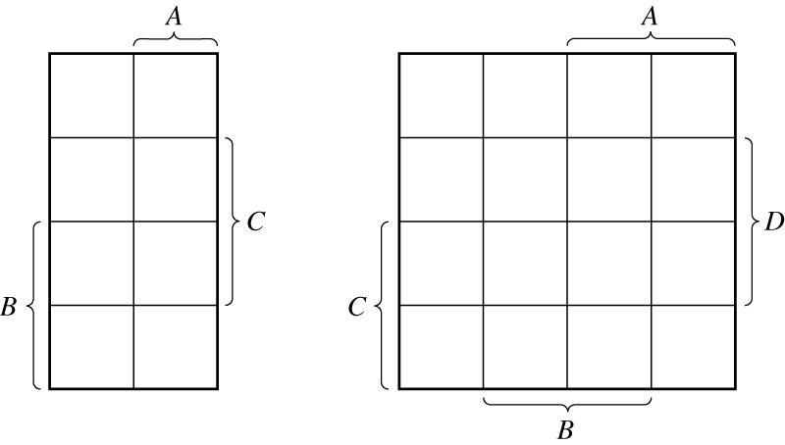
5.7 Other Forms of Karnaugh Maps
Roth version
(Veitch Diagrams)
M. Mano version
11
10

Slide 35
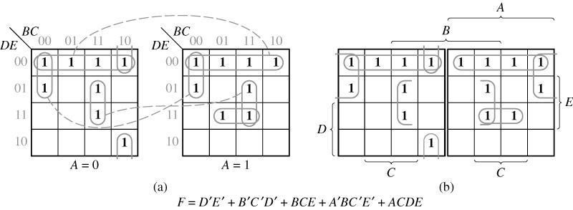
5.7 Other Forms of Karnaugh Maps
Other Forms of Five-Variable Karnaugh Maps

